Slide 1


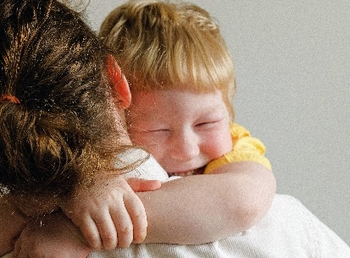

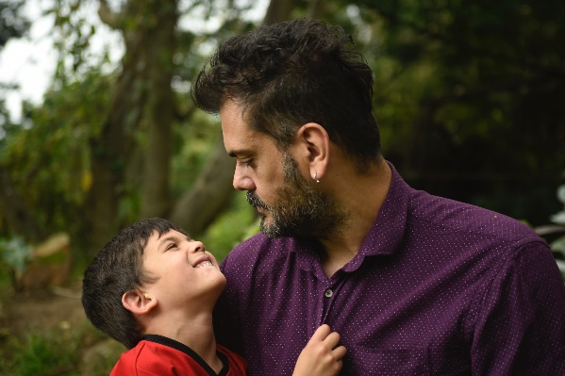

Making a Difference
Mandate to Report and Responsibility to PREVENT
Child Abuse and Neglect

Slide 2

PURPOSE
This workshop will help mandated reporters of suspected child abuse and neglect understand their role and responsibilities to help protect and support children.
Notes:
People are concerned with the decline in calls to CPS during the pandemic. They are worried that kids are less safe because kids have less contact with other protective adults in the community. However, we know that parental stressors are a higher risk factor for abuse and neglect than proximity to mandated reporters. This session will explore how we can support families in our community, so that abuse/neglect doesn’t happen in the first place. We will discuss how we can shift from “mandated reporting” and a culture surveillance of families to “mandated supporting” and a culture of support for families.

Slide 3
LEARNING OBJECTIVES
Participants will be able to:
Identify signs and indicators of child abuse and neglect,
Understand what to do when a child discloses abuse or neglect, and
Implement strategies and approaches that help prevent abuse and neglect from occurring.

Slide 4
An Overdue Conversation
Child abuse and especially sexual abuse is rarely discussed.
Conversation has historically been taboo.
Recent attention to the impact of sexual abuse and assault on children and vulnerable people. Individuals and communities are starting to act.

Slide 5
Nature of Abuse
Over 90% of the time children are abused by someone they know—often someone who is supposed to protect them.
In almost every case, the only witnesses are the perpetrator and the victim.
Children rarely report abuse immediately.

Slide 6
Facts about Child Maltreatment
Over 130 years since first recognition of child abuse in the U.S.
The estimated costs of treating the effects of child maltreatment are over $103 billion per year.
(Source: Prevent Child Abuse America)

Slide 7
Facts about Child Maltreatment
In West Virginia (2020):
37,395 total CPS referrals
Referral rate 105.8 / 1,000 children
24,104 referrals (63.9%) were screened in for a CPS response
6,411 substantiated cases
6,116 child victims
17.2 victims per 1,000 children
Notes:
Data is from 2020 Child Maltreatment Annual Report published by the U.S. Department of Health & Human Services in Jan. 2022,
https://www.acf.hhs.gov/sites/default/files/documents/cb/cm2020.pdf

Slide 8
1 in 10 children in West Virginia will be a victim of sexual abuse by age 18.
Notes:
According to 2017 BRFSS Data.

Slide 9
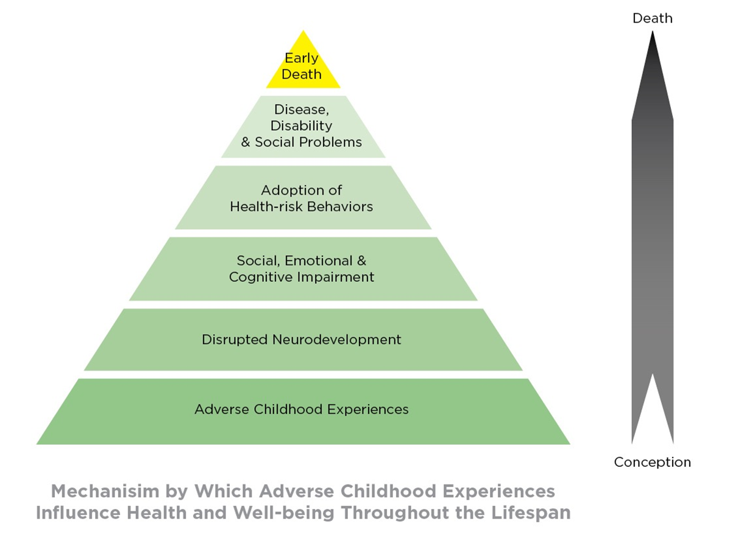

Slide 10
Adverse Childhood Experiences (ACEs) have long term effects.
Increased risk for:
Alcoholism
Depression
Domestic violence
Drug abuse
Heart disease
Liver disease
Dropping out of school
Smoking
Suicide attempts
Notes:
More information about the Adverse Childhood Experiences Study (ACES) is available online at http://www.wvaces.org/.

Slide 11
Responsibility to Prevent
“No epidemic has ever been resolved by paying attention to the treatment of the affected individual.”
-- George W. Albee, Ph.D.

Slide 12
Concerns with over reliance on mandated reporting
A culture of surveillance discourages people from seeking help. With help comes consequences.
Reporting is subject to racial bias. Nationally, 53% of children in Black families will be subject to a CPS investigation prior to their 18th birthday.
No evidence of correlation between children being safer in jurisdictions with stricter mandated reporter laws than others.
Reporting creates an adversarial relationship that undermines trust.
Most reports are screened out because they are not abuse or neglect.
Unwarranted reports delay CPS response times

Slide 13

A note about brain science.

Slide 14
Our brains are wired to see risk, which keeps us safe.
HOWEVER, we need to use our ”upstairs brain” when assessing whether a call to CPS is warranted or if a child’s needs can be met through support versus surveillance and investigation.

Slide 15
“I had a neighbor call the cops on me. My daughter had just come back from foster care, and the transition was hard for her. She was having a meltdown. I explained this to the cop. He said, “I understand. You’re doing a good job.’ And he left. I went to my neighbor and explained the situation to her, too. She apologized. I asked her to please ask me if I needed help before calling the authorities on me again.”
“In our town, a member of the town council holds an “exercise boot camp” for families. It’s a way for them to engage and stay healthy. Through the program, you can see children improve behaviorally and physically.”
“Listening is one of the best gifts we can provide to anyone. I’ve noticed, during the pandemic, that we’re going through situations that we’ve never gone through before. Make sure they feel like they aren’t the only ones. I tell them: you aren’t the first one who doesn’t know how to get through this.”
“When I became a teacher, I realized that some teachers judge parents a lot. I’m a mother of a special needs child, and when I heard other teachers making judgments on things like dirty shirts, I wondered what teachers had been saying about my child and my parenting. Instead of judging, we should be asking ourselves how you can help.”
“I met a family who yelled whenever they talked to each other. At first glance, I was concerned, but through further observation, I recognized that there was love and safety in this family. They were loud, but the yelling was not abusive- it was cultural. Through a parenting class, the grandmother learned tools to use a gentler approach, if she wished.”
“Once, an older couple walked up to me while my four-year old son was melting down, and said, “you’re doing great.” I felt so supported, I was walking on air.”

Slide 16
What are different forms of child maltreatment?

Slide 17
Physical Abuse Definition
Non-accidental physical injury of a child; intentionally harming a child, use of excessive force, reckless engagement

Slide 18
Sexual Abuse Definition
Engaging a child in any activity for an adult’s own sexual gratification. Any act of sexual assault, abuse, or exploitation of minors. Sexual abuse encompasses a broad range of behavior and may consist of many acts over a long period of time or a single incident.

Slide 19
Neglect Definition
Neglect is the most common form of child maltreatment. Neglect is failure to provide for a child’s physical survival needs to the extent that there is harm or risk of harm to the child’s health or safety. Physical neglect may include, but is not limited to abandonment, lack of supervision, lack of adequate hygiene, lack of adequate nutrition, lack of adequate shelter, lack of medical or dental care, and/or lack of required school enrollment or attendance.
Note: A child is NOT to be considered neglected under WV law when the failure, refusal, or inability to provide for the child is due to a lack of financial means on the part of the parent, guardian, or custodian.

Slide 20
Emotional Maltreatment Definition
The systematic diminishment of a child. It is designed to reduce a child’s self-concept to the point where the child feels unworthy of respect, unworthy of friendship, and unworthy of love and protection. Can include patterns of verbal assaults, including screaming, intimidating, rejecting, ridiculing, threatening, blaming, sarcasm; ignoring and indifference; constant family conflict.
Note: Cases of emotional abuse are extremely difficult to prove. A cause-and-effect relationship between the parent or caregiver’s acts and the child’s response must be established.

Slide 21
What are some potential warning signs and indicators?
Notes:
Form small groups of 4-6 and ask participants to take five minutes to share answers to the question.
After 5 minutes ask each small group to report out.
Contribute additional information on warning signs and indicators as needed.
Refer participants to Supplementary Participant Handouts in Tab 4 for more information.

Slide 22
Questionable bruises and burns
Questionable fractures (in various stages of healing)
Questionable cuts and scrapes (to mouth, eyes, external genitalia)
Behavioral extremes
Wears inappropriate clothing for season to hide injuries
Physical & behavioral indicators of possible physical abuse
Notes:
Additional information in the handouts.

Slide 23
Difficulty walking or sitting
Torn, stained, or bloody underwear/diaper
Massive weight change
Overly compliant, passive behavior aimed at maintaining a low profile
Hostility or aggression
Unusual sexual behavior or knowledge
Physical & behavioral indicators of possible sexual abuse
Notes:
Additional information in the handouts.

Slide 24
Consistent hunger, poor hygiene, inappropriate clothing
Consistent lack of supervision
Unattended physical or health problems
Begging or stealing food
Constant fatigue or falling asleep
Frequently absent
Self destructive
Physical & behavioral indicators of possible child neglect
Notes:
Additional information in the handouts.

Slide 25
Lags in physical development
Failure to thrive
Behavior extremes; compliant, passive, aggressive, demanding, etc.
Overly adaptive behavior: “Parents” other children inappropriately
Self-destructive, attempted suicide
Physical & behavioral indicators of possible emotional abuse
Notes:
Additional information in the handouts.

Slide 26
Mandate to Report
All About Reporting
Notes:
If embedded video doesn’t work, play Section 2 of DVD, All About Reporting

Slide 27
Who Must Report
WV Code §49-2-803
School teachers and other school personnel
Social service workers
Childcare or foster care workers
Medical, dental, or mental health professionals
Emergency medical services personnel
Law enforcement officials
Circuit court judges, family court judges, or magistrates
Humane officers
Member of the clergy
Christian Science practitioners
Religious healers
Youth camp administrator or counselor
Employee, coach, or volunteer of an entity that provides organized activities for children
Commercial film or photographic print processor
Notes:
Refer to Tab 5 Participant Handout, which answers common questions about who should report

Slide 28
New Requirements
Per SB 465 (effective June 5, 2018)
Implements Legislative Task Force on the Prevention of Child Sexual Abuse Recommendations
Cleans up WV Mandated Reporter Statute
Shortens timeframe for making a report to no more than 24 hours
Requires direct reporting by individual who receives disclosure or suspects any abuse
Notes:
SB 161 is included on Trainers USB Drive

Slide 29
Recognize a child’s attempt to communicate their concerns:
Children may ask questions about bodies, interactions, or sex rather than talk directly about something they’ve experienced
Children may tell parts of what happened, or pretend it happened to someone else to check your reaction
Children will often shut down and refuse to tell more if you respond emotionally or negatively

Slide 30
TYPES OF DISCLOSURE
Indirect Hints
“My babysitter keeps bothering me.”
Disguised Disclosure
“I know someone who is being touched in a bad way.”
Disclosures with Strings Attached
“I have a problem, but if I tell you about it, you have
to promise not to tell.”

Slide 31
What should you do when a parent or child discloses?
Notes:
Distribute Disclosure Job Aid Cards to participants (Tab 6).
Process with them.

Slide 32
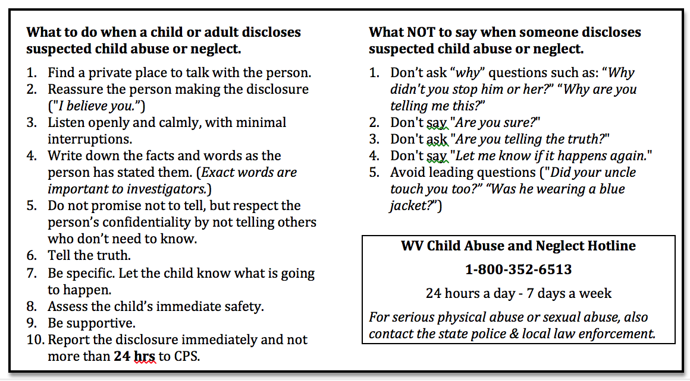
What to do when a child or adult discloses suspected abuse or neglect?

Slide 33
To Whom Do You Report?
WV Child Abuse and Neglect Hotline
1-800-352-6513
24 hours a day – 7 days a week
For serious physical abuse and sexual abuse, also contact the state police and local law enforcement.
Notes:
to What Happens When You Make a Report Handout Tab 7. Prompt the participants to read the handout pages and mark their questions. Open the floor and respond to questions. Strive to maintain focus on reporting which is the purpose of this training vs. the complexities of CPS response.
Note that the initial report will take longer than in the past, due to implementation of the SAMS (Safety Assessment & Management System) Model.

Slide 34
How do you make a report?
Call WV Child Abuse and Neglect Hotline, 1-800-352-6513.
For serious physical abuse or sexual abuse, also contact the state police and local law enforcement.
You should contact Child Protective Services (CPS) whenever you reasonable suspect a child has been abused or neglected or is subject to conditions where abuse or neglect is likely to occur.
CPS will accept your report and determine, “Is the child safe or does the child need protected?”

Slide 35
What happens when you make a report?

Slide 38
What will CPS ask when you make a report?
When making a report, the mandated reporter may be asked information concerning the following:
Client – family demographics
Alleged child abuse and/or neglect
Specific caregiver behavior indicative of child abuse and neglect
Events and circumstances associated with or accompanying the child abuse or neglect
Effects of child abuse or neglect; present danger and/or impending danger; caregiver behavior on child; child’s condition resulting from the child abuse or neglect; and/or family condition

Slide 39
What will CPS ask when you make a report?
Available information about the child(ren) including:
General condition and functioning
Location
State of mind/emotion; specific fear
Proximity of threat
Access to those who can help and protect

Slide 40
What will CPS ask when you make a report?
Available information about the caregiver(s) including:
General functioning
General parenting
General state of mind/emotion
Current location
Community relations
Employment
Use of substances
Mental health functioning
Attitudes toward/perceptions of child(ren)
Previous relevant history, including CPS history
Likely response to CPS

Slide 41
What will CPS ask when you make a report?
Available information about the family including:
Domestic violence, including power, control, entitlement
Living arrangements
Household composition
Household activity – including people in and out
Condition of residence
Description of any possible/likely emergency circumstances
Identification of protective adults who are or may be available
The reporter’s name, relationship to the family, motivation and source of information, if possible: why the reporter is reporting now; and any actions that the reporter suggests could occur
Information concerning the name and the contact information for biological parents who are not subject of the report
The names and contact information of other people with information regarding the child and/or family

Slide 42
To Whom Do You Report?
WV Child Abuse and Neglect Hotline
1-800-352-6513
24 hours a day – 7 days a week
For serious physical abuse and sexual abuse, also contact the state police and local law enforcement.
Notes:
Refer to What Happens When You Make a Report Handout Tab 7. Prompt the participants to read the handout pages and mark their questions. Open the floor and respond to questions. Strive to maintain focus on reporting which is the purpose of this training vs. the complexities of CPS response.
Note that the initial report will take longer than in the past, due to implementation of the SAMS (Safety Assessment & Management System) Model.

Slide 43
Preventing Child Sexual Abuse Adult Boundary Violations
Notes:
Distribute Disclosure Job Aid Cards to participants (Tab 6).
Process with them.

Slide 44
Pays Special Attention to a
Particular Child
Abusers will look for children who appear vulnerable or hungry for attention, children who spend time alone or are unsupervised or children who seem isolated
The child is then singled out for praise, gifts, special outings, or special favors. The offender promotes it as a “special relationship”.
They may take pictures or videos of the child.
They communicate excessively with the child via phone, text, email, or the internet.
They offer to babysit the child, including sleepovers and overnight trips.
Many of these behaviors allow the abuser to gain trust with the caregivers.

Slide 45
Breaks Boundaries or Rules
Abusers may give a child treats, gifts, or special privileges not allowed by their parents.
In other cases, they may provide children with drugs or alcohol and treat them as if they are older.
They may often test a child’s boundaries by using inappropriate language or telling dirty jokes.
They may show child pornography to initiate sexual interest and to normalize the behavior.

Slide 46
Is Overly Physical
Abusers break down children’s natural defenses to physical touch. They insist on hugging, touching and kissing even if the child objects. They also play body contact games like tickling and wrestling. They encourage lap-sitting and backrubs.
They often craft situations for non-sexual or “accidental” touch.
They ignore a child’s need for privacy by walking in on the child while they are in the bathroom or dressing.

Slide 47
Encourages Secrecy
Abusers often mask the preceding behaviors and the abuse that follows by creating a shared “secret”. They might say, “Don’t tell your mom I let you watch that R rated movie, it will be our secret”.
Abusers will even use threats to keep children from telling: “If your parents knew, you’d get in a lot of trouble”.

Slide 48
Other Inappropriate Behaviors
Abusers may make sexual comments or observations about children or a child’s developing body.
Adults who seem excessively focused on children to the exclusion of healthy adult relationships should cause concern.
An adult who is overly helpful to the point of being ‘too good to be true” should also cause concern.

Slide 49
Minimize Opportunity
More than 80 percent of sexual abuse incident happen in isolated, one-on-one situations with a child.
So, if you eliminate or reduce these isolated, one-on-one situations, you’ll dramatically lower the risk.
All encounters with children should be
      Observable
      Interruptible

Slide 50
ADDITIONAL TIPS
Pay attention to gut feelings
Acknowledge a child’s resistance to a specific person or situation
Don’t force a child to hug or kiss anyone
Talk to your child about body safety, tell them you will believe them if they tell you something serious is going on
Use the correct medical terminology for body parts
Talk to your child about “secrets”, use the word surprises instead

Slide 51
CPS Hotline
WV Child Abuse and Neglect Hotline
1-800-352-6513
24 hours a day - 7 days a week
For serious physical abuse and sexual abuse, also contact the state police and local law enforcement.
Notes:
Refer to What Happens When You Make a Report Handout Tab 7. Prompt the participants to read the handout pages and mark their questions. Open the floor and respond to questions. Strive to maintain focus on reporting which is the purpose of this training vs. the complexities of CPS response.
Note that the initial report will take longer than in the past, due to implementation of the SAMS (Safety Assessment & Management System) Model.

Slide 52
For More Information Contact:
Jim McKay
State Coordinator
Prevent Child Abuse WV
304-617-0099
Email: jim@teamwv.org
http://www.preventchildabusewv.org

